Slide 1

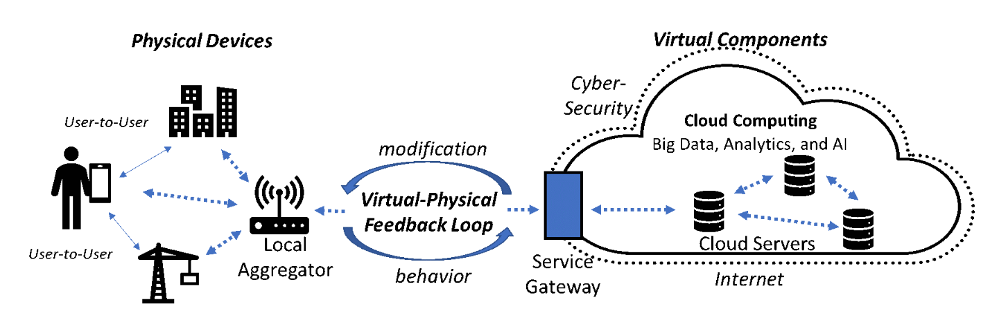

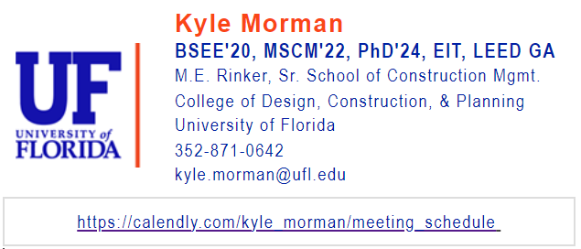
Connected jobsites:
Network and Device Integration
Notes:
Some of you may have asked yourselves why the internet-of-things has taken 20+ years to gain any stable traction, particularly in the construction domain.
With my background in electrical engineering, research in construction management, and inherent sustainability focus, hopefully I can tell you.

Slide 2
Overview of Network and Device Integration
Problems:
Labor
Power
Connectivity
Complexity
Interoperability
Usability
Cost
Solutions:
New Workforce
Energy Harvesting
Artificial Intelligence
Standardization
Open-Source
Ruggedness
Notes:
In order to successfully integrate wireless communications inherent to IoT and the smart-construction-site, one must recognize the interrelatedness of all problems involved.
It takes labor to build, whether that means constructing the building, the power grid, or the communications grid… and many workers are required for a successful process.
Resulting from the numerous attempts at wireless connectivity solutions however… network complexity is great, proprietary focus has hindered, and field-usability has lacked.

Slide 3
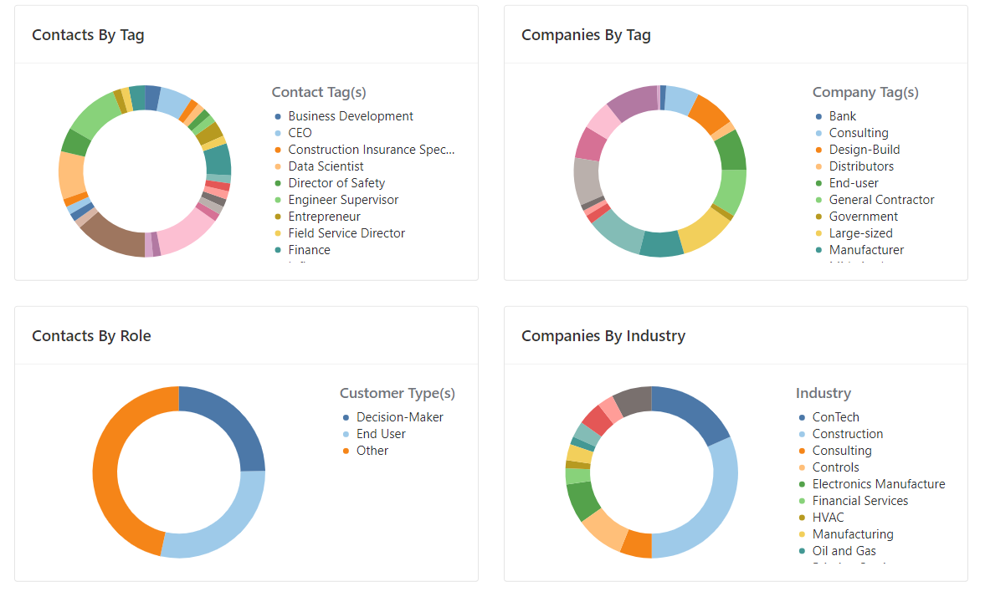
Notes:
To further the validity of this research, it should first be mentioned that the notions involved herein come as a result of hundreds of professional interviews,
With various parties involved in the construction proves, various company types, various “power” in the business hierarchy, and various industries related to the built environment.

Slide 4
Why is connectivity the issue?
Biggest problem in construction is labor.
Most common approaches to solution are incentivization and technology.
Incentivization is expensive and doesn’t help the lack of skilled labor.
Technology and computers are efficient, cheap, accurate, & precise.
The problem with tech-integration is nearly always connectivity.
Thus, the biggest problem with technology in construction is the network.
Ex. even building the new football stadium in downtown Jacksonville, the network hindered the field crew’s ability, and they transferred data from the office.
Notes:
So why is connectivity the issue in question?

Slide 5
Answer: Complexity
Why is connectivity the issue?
Job site: trades, materials, environment, equipment…
Business: type, structure, owner requirements…
Network: spectrum, protocol, hardware, software…
Notes:
The reason is complexity. Construction sites have a variety of trades involved, with a constant flow of materials and equipment subject to immediate change.
The nature of construction is highly fragmented too, when compared to other industries, which I will discuss further on the following slides along with network difficulties.

Slide 6
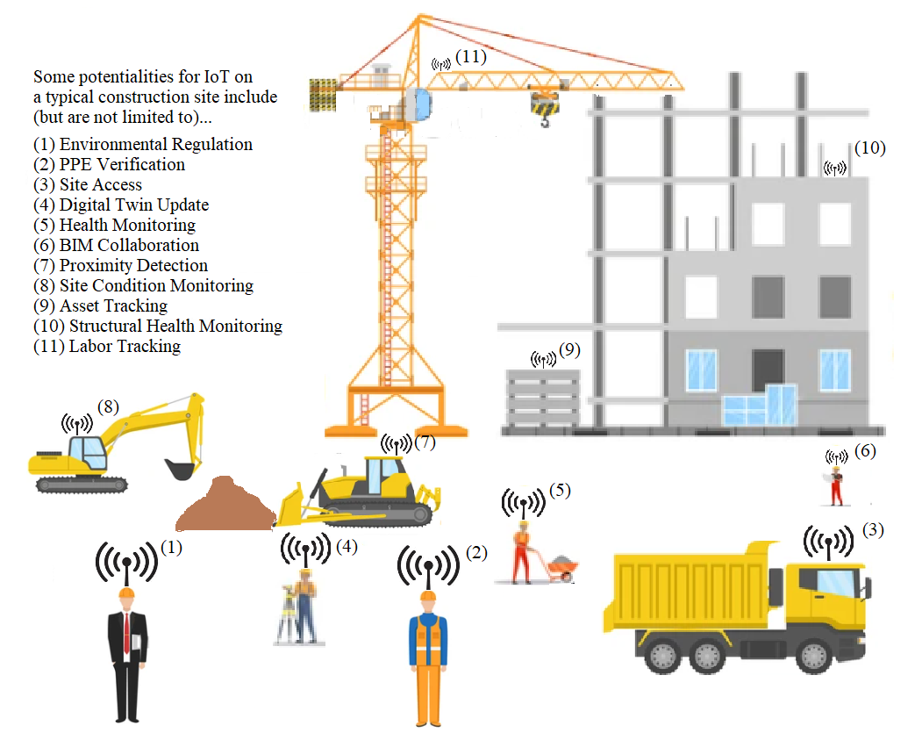
Notes:
IoT hosts many benefits to construction, from the data-light sensor nodes that provide environmental monitoring and asset tracking…
To the highly complex, data-heavy, BIM collaboration tools used for digital twin development, and augmented or virtual reality presentation systems.

Slide 7
Problems
Notes:
So, what are the specifics on the problems mentioned in our research overview?

Slide 8
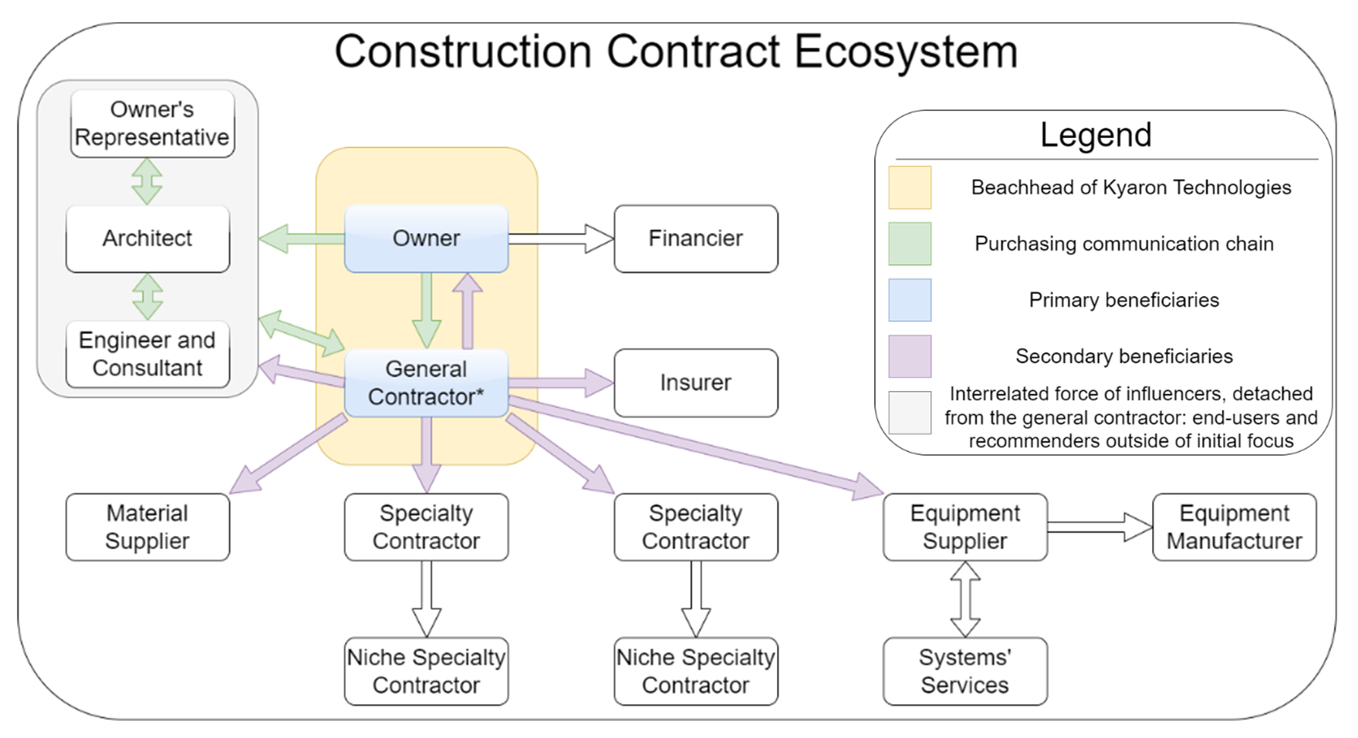
PROBLEMS: 1.) Labor
Network Purchase
Notes:
Yes, the construction ecosystem is a complex domain with many parties involved, and many parties can benefit from a successful deployment.
However, in any construction endeavor, it takes the buy-in of the purchasers of the building and the executives of the lead contracting firm to ensure such success.

Slide 9
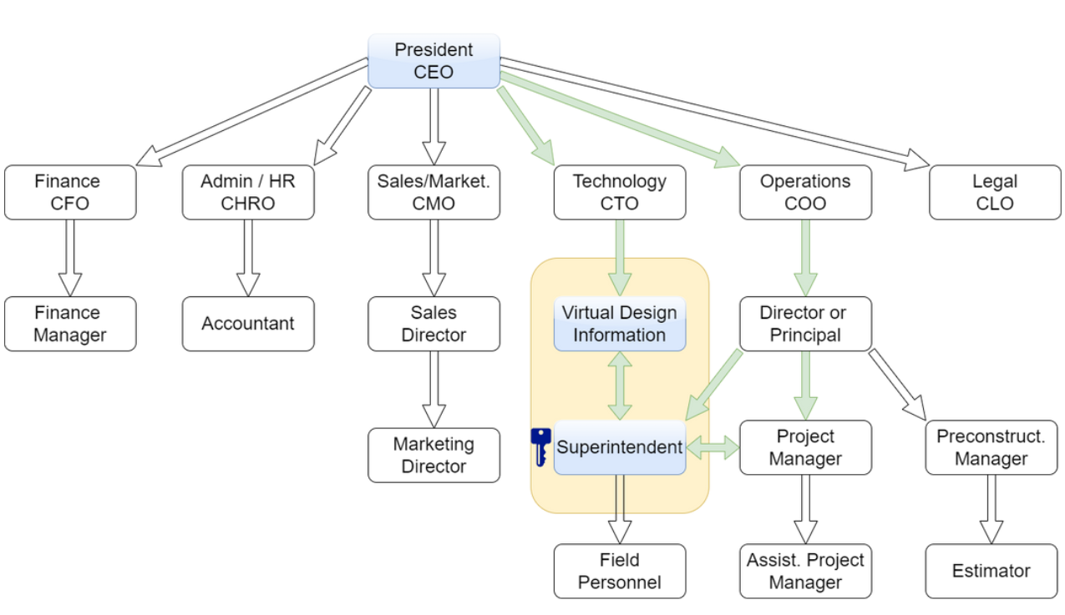
Construction Company Ecosystem
Notes:
Furthermore, even in a single construction organization, many parties have a stake in the incorporation of IoT: from executives and directors, to estimators and project managers…
To virtual design coordinators, information technologists, and field-crew managers. This complexity is a hindrance to IoT because the party with purchasing power (executive/estimation) has…
a different perspective from the party with technological capability (VDC/IT), which has a different perspective from the crew most likely to benefit from a robust site network (field personnel)

Slide 10
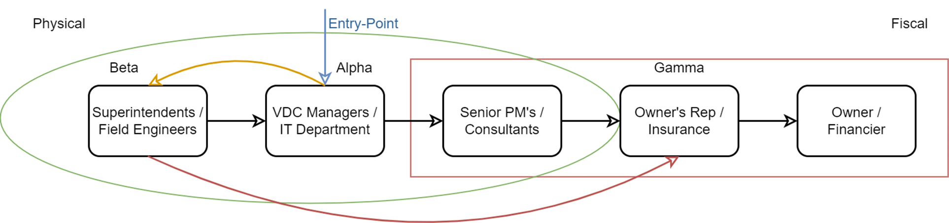
How is a network or technology incorporated into a construction site?
Notes:
The reason VDC and IT are considered alongside the seemingly unrelated field managers comes from the question: how is a network or technology incorporated into the job site?
The suggestion to develop a robust network early in the construction process likely comes from a tech-savvy professional like the VDC or IT department with considerable data needs.
However, without the buy-in of the typically tech-averse field personnel, the necessary tools and labor for network development are unlikely to make the bid-sheet approved by senior PMs.

Slide 11
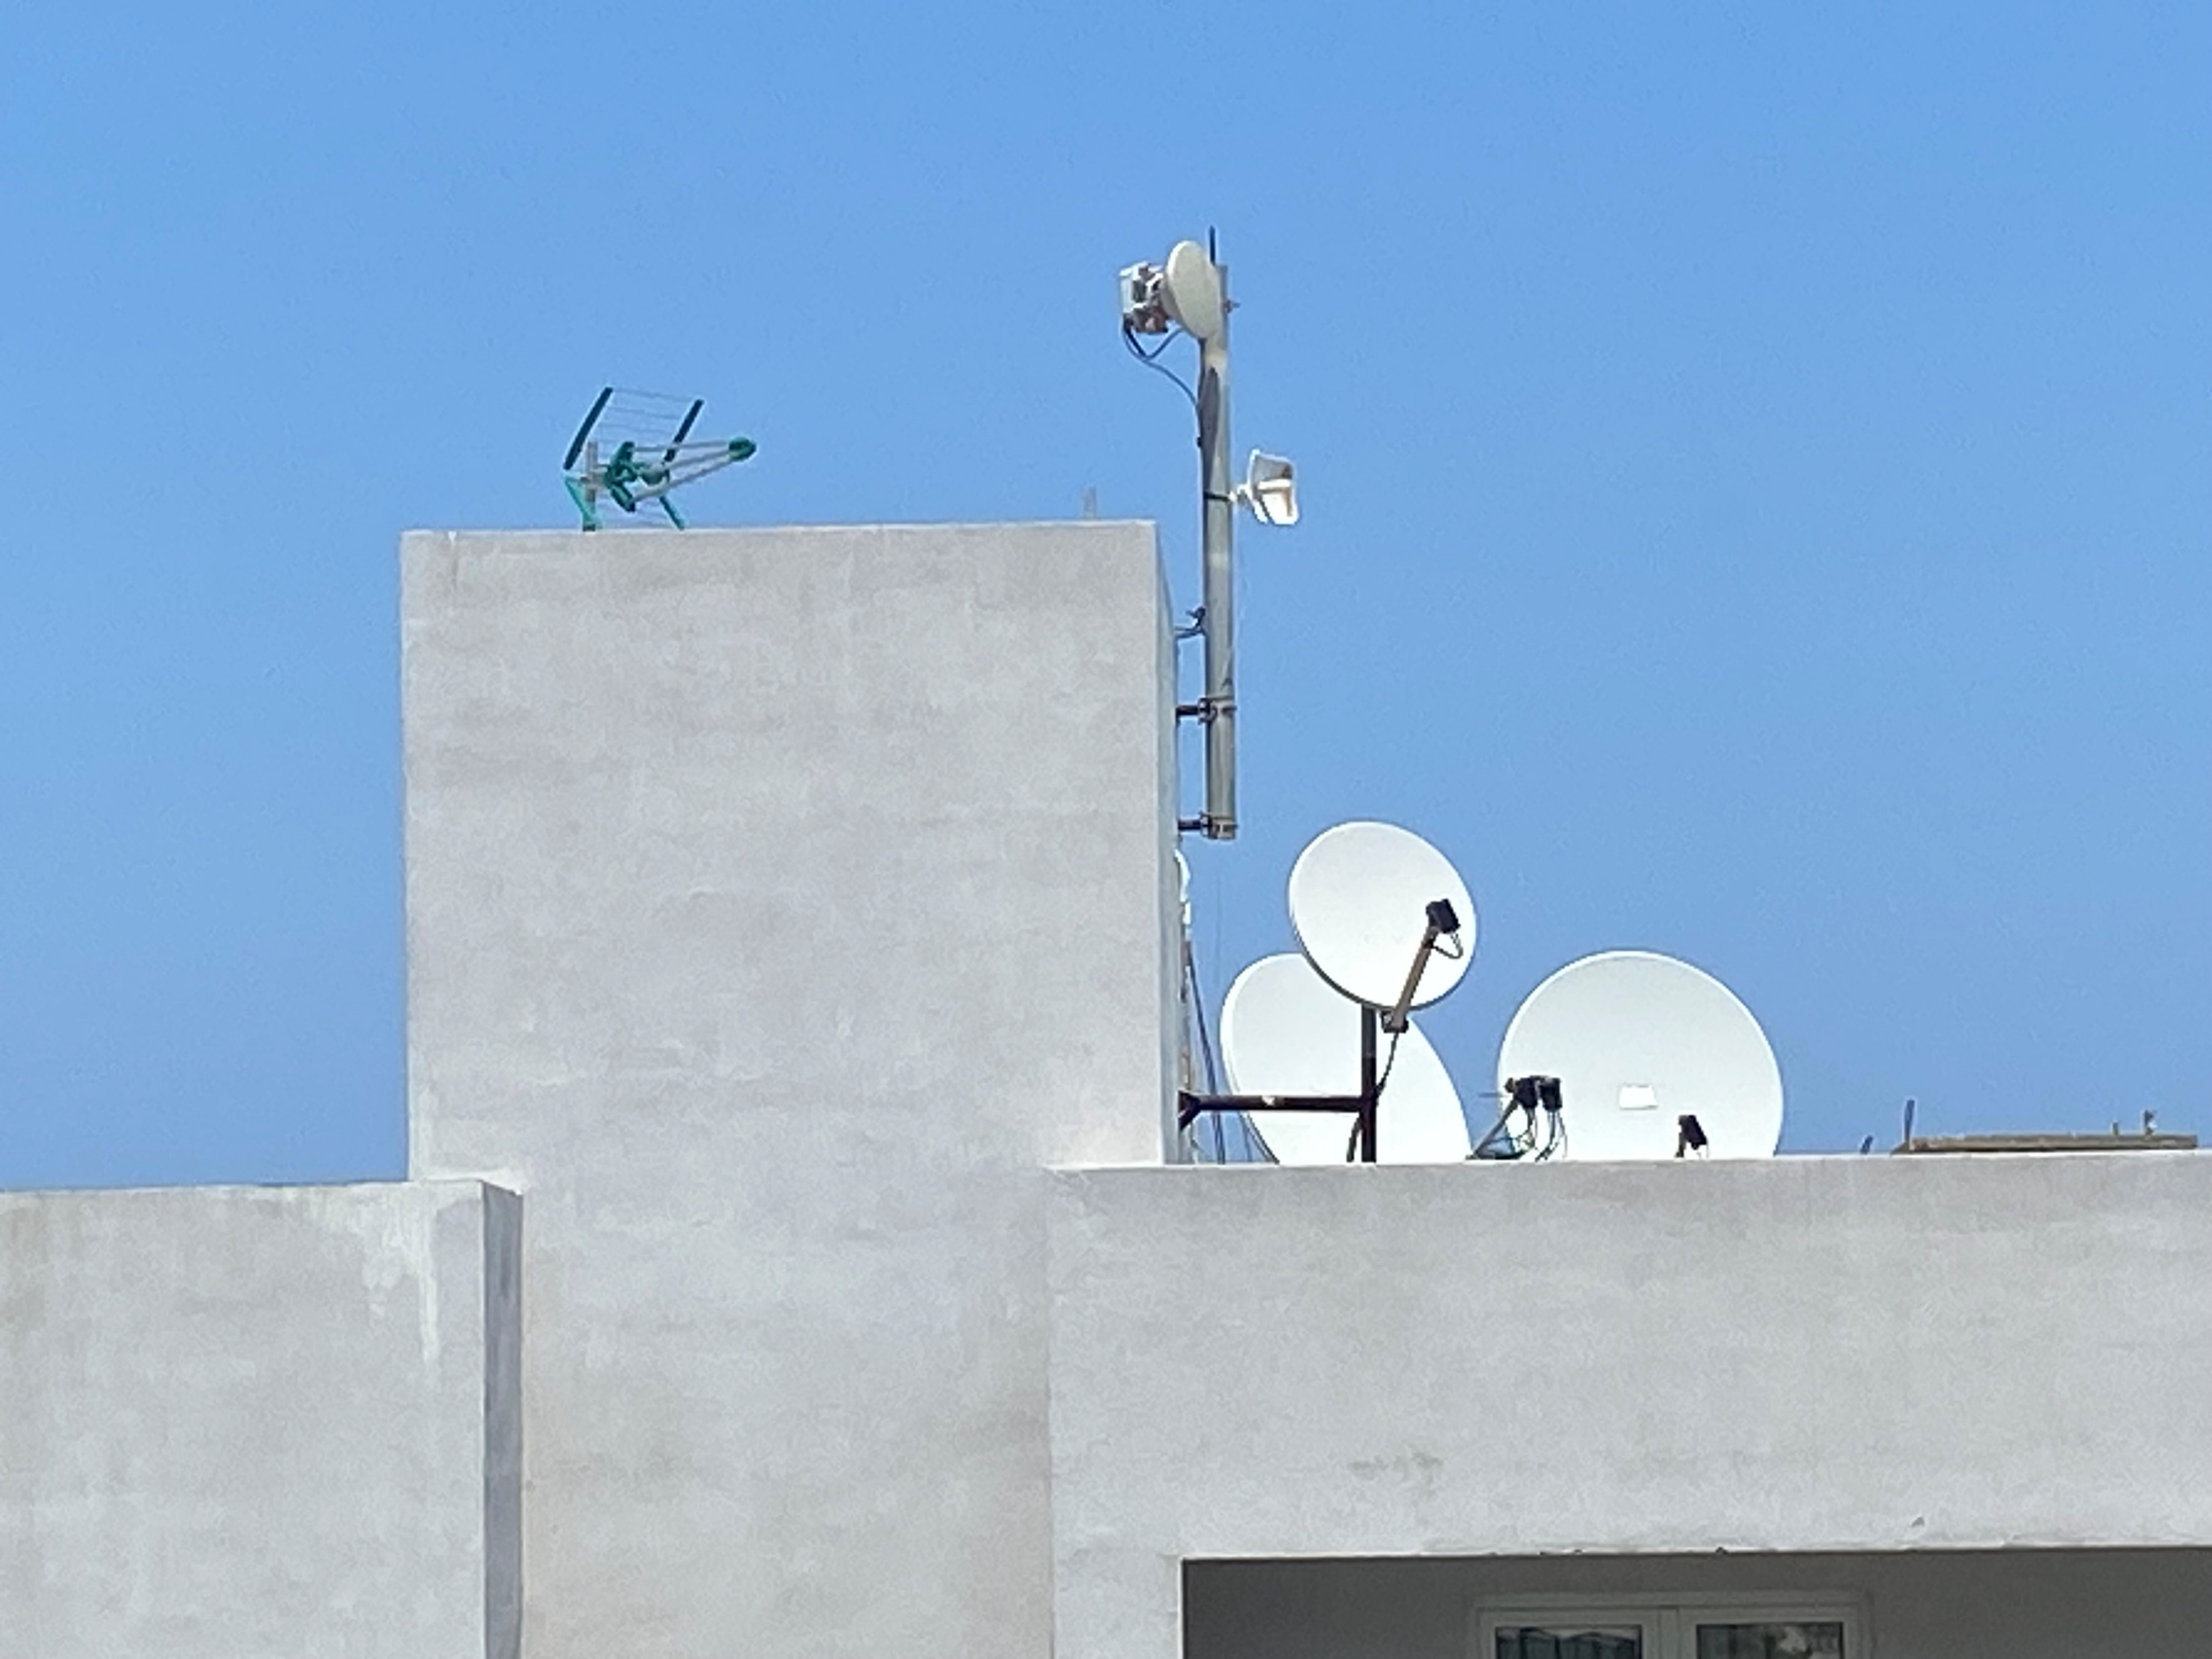
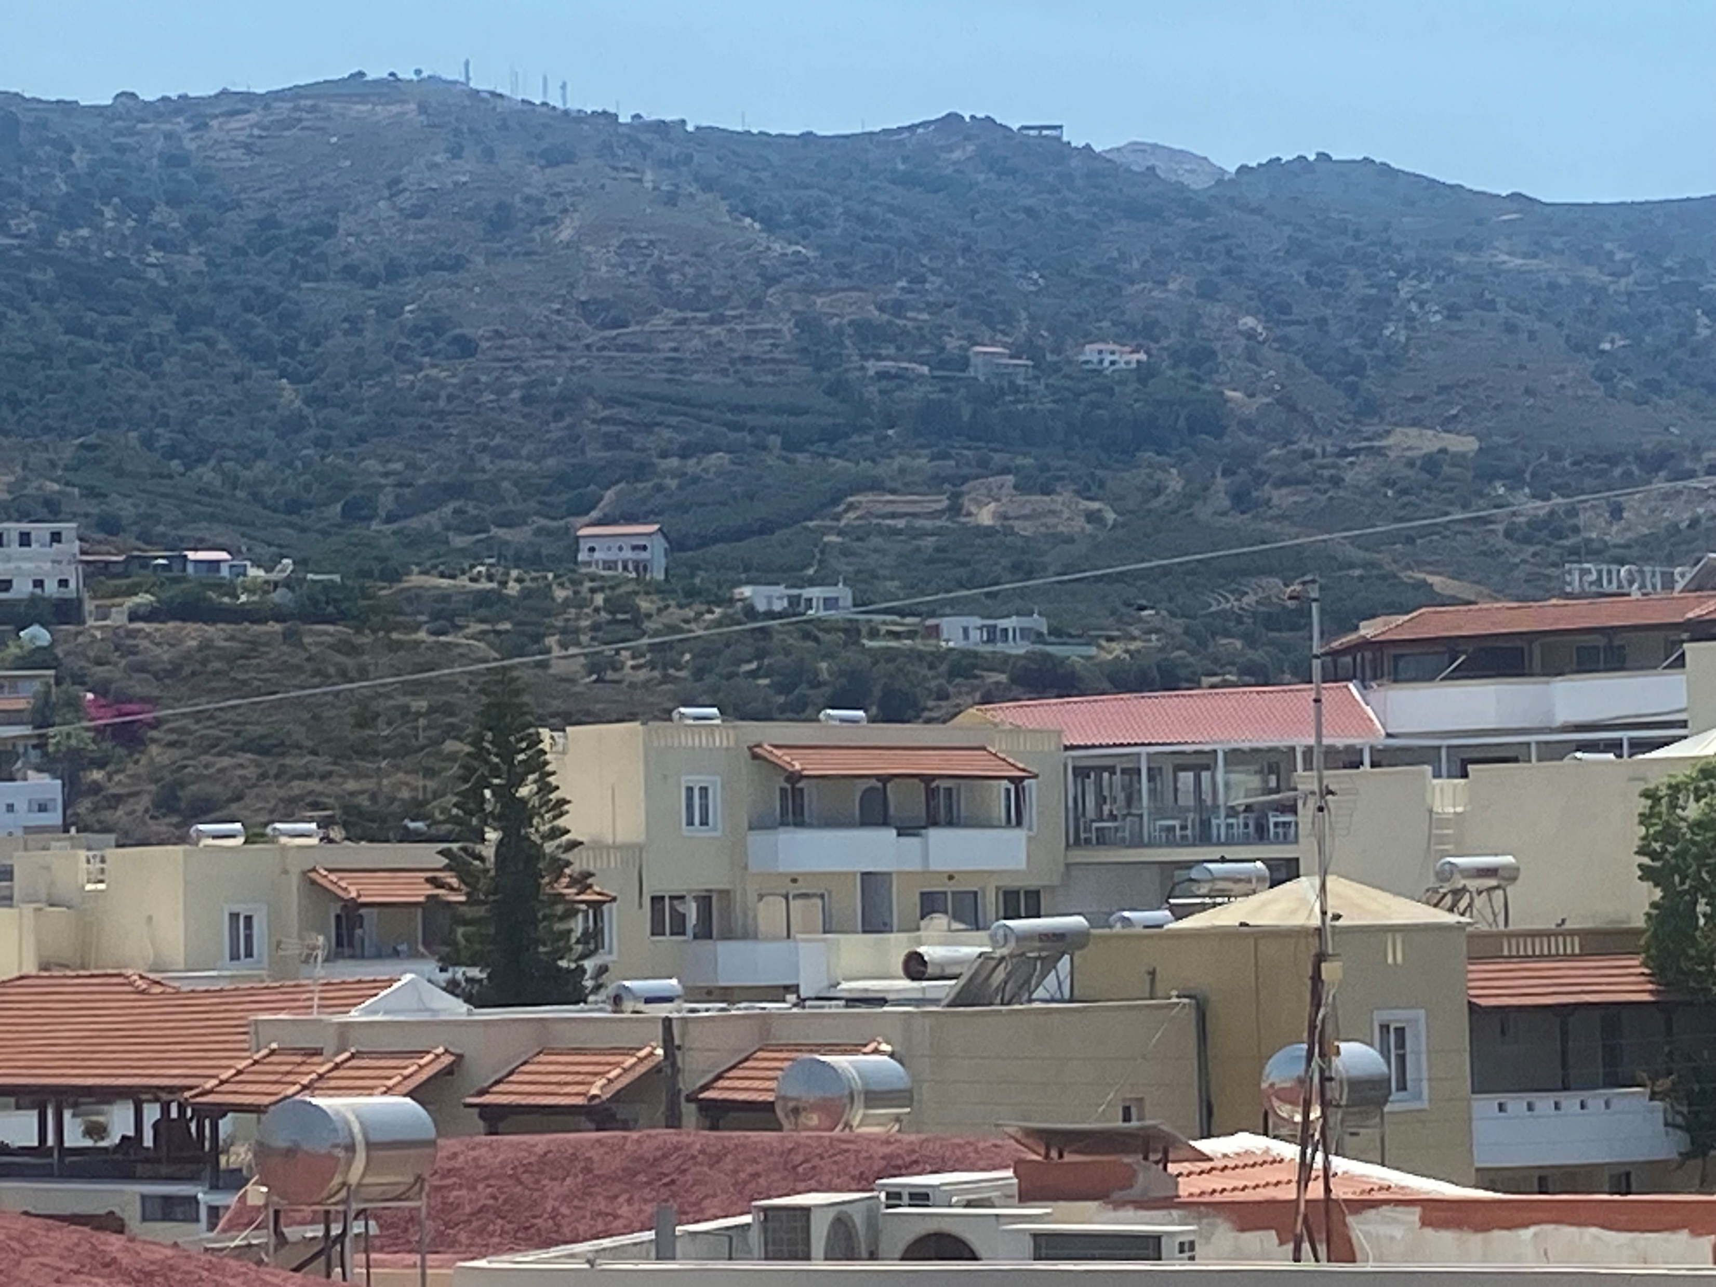

PROBLEMS: 2.) Power
Cellular
Satellite
Signal Boosters
Notes:
Moving on… Question: who amongst the audience has experienced connectivity problems here at EC3? This is a relatively densely populated location with notable infrastructure.
Personally, working outside within the line-of-sight of satellite, cellular, and Wi-Fi booster antennae, I was receiving 55.7KB/s download speeds… which is dismal.
Consider then, how much is this inadequacy exacerbated in locations where there is not only unavailable cellular infrastructure, but lacking powerline infrastructure as well?

Slide 12
Answer: Complexity
Why is connectivity the issue?
Job site: trades, materials, environment, equipment…
Business: type, structure, owner requirements…
Network: data-allocation, protocol, spectrum, hardware, software…
Notes:
Now that we’ve seen how complex the integration of connectivity within construction can be due to domain-specific factors inherent to building,
let’s quickly consider how complex network development can be from a technical perspective.

Slide 13
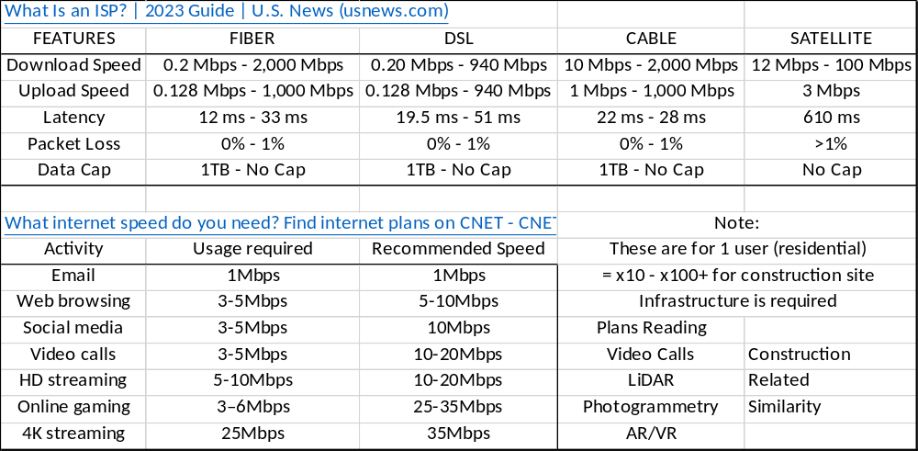
PROBLEMS: 3.) Connectivity
Notes:
The various aforementioned wireless communications needs (from remote monitoring to field communications to automation and robotics) have different data requirements, and the different methods of providing internet service have different capabilities… but the range of these requirements and capabilities are several orders of magnitude.
Furthermore, even though this image seems to indicate current provisions are adequate, consider that these numbers are for private residential internet use: inadequate for construction needs.

Slide 14
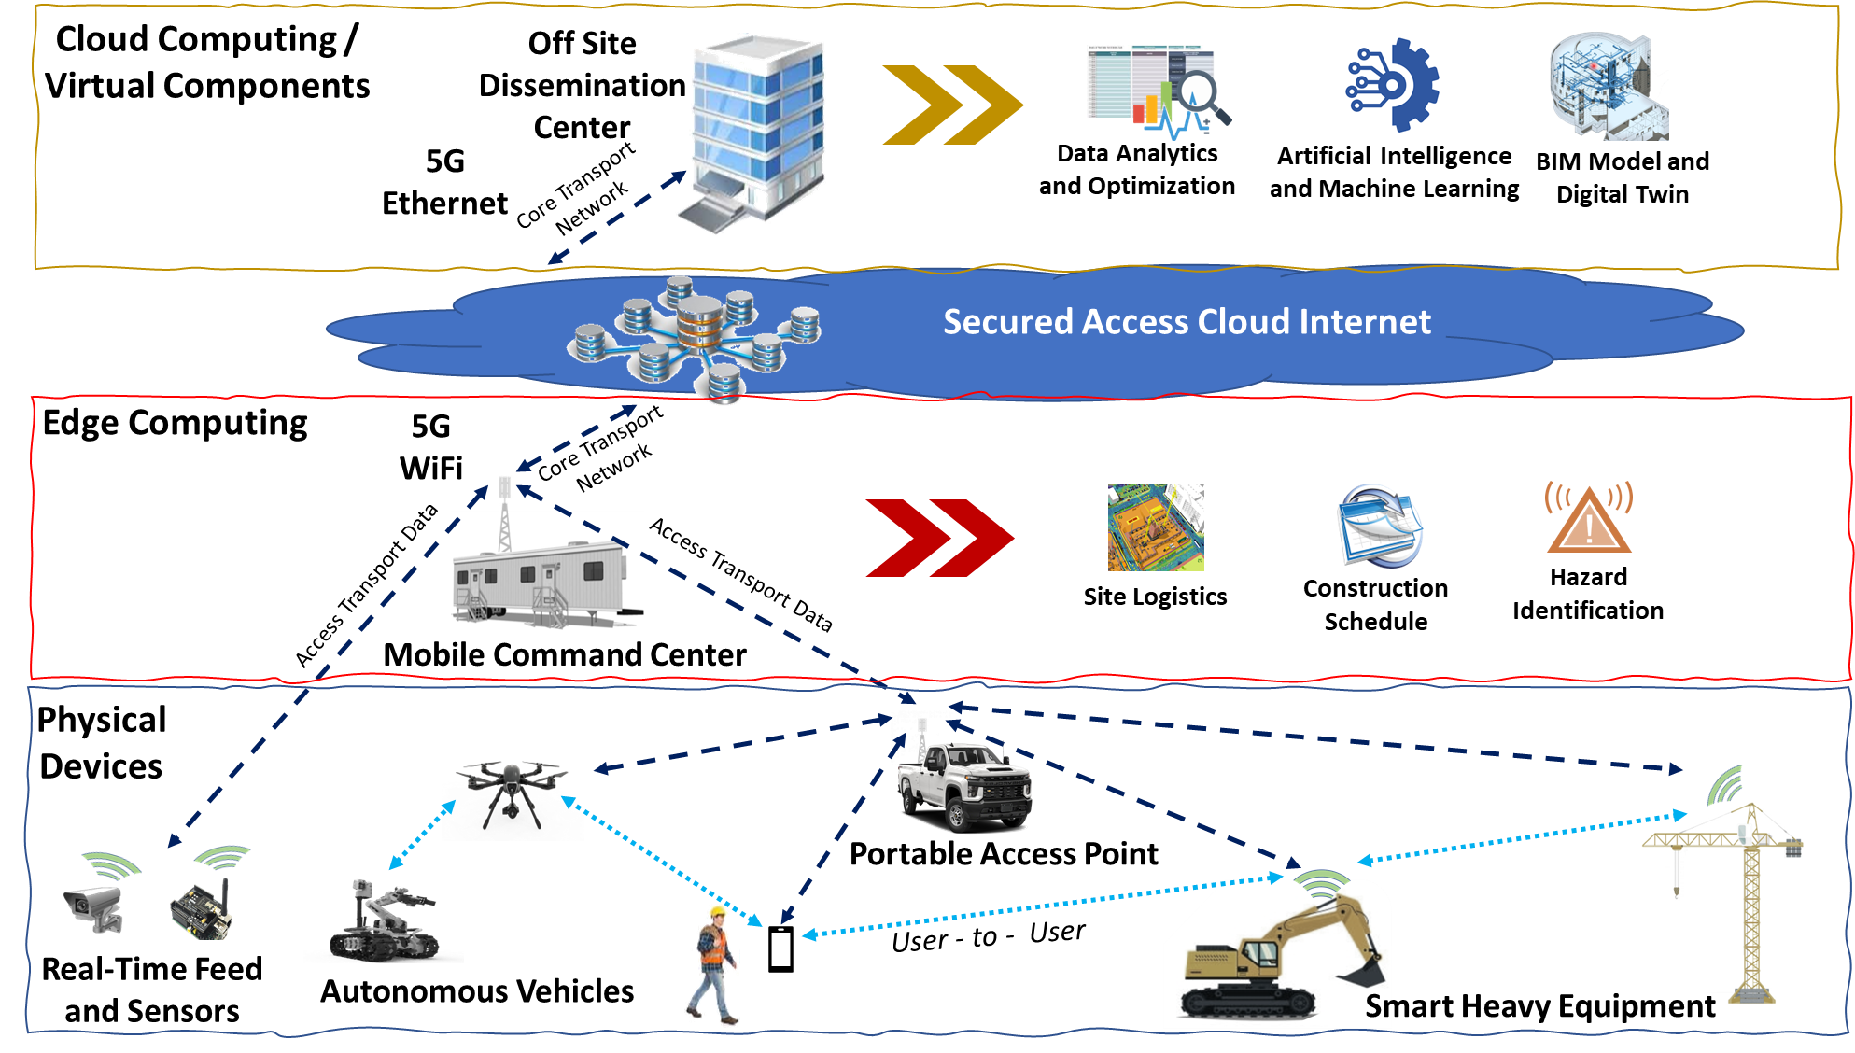
Notes:
As a result, in order to truly appreciate the benefits of big data analytics, artificial intelligence, building information modeling, and digital twin (in the cloud)…
The connectivity issues at the edge and within the physical devices must first be solved to ensure sufficient throughput, bandwidth, and consistency of information transmission.

Slide 15
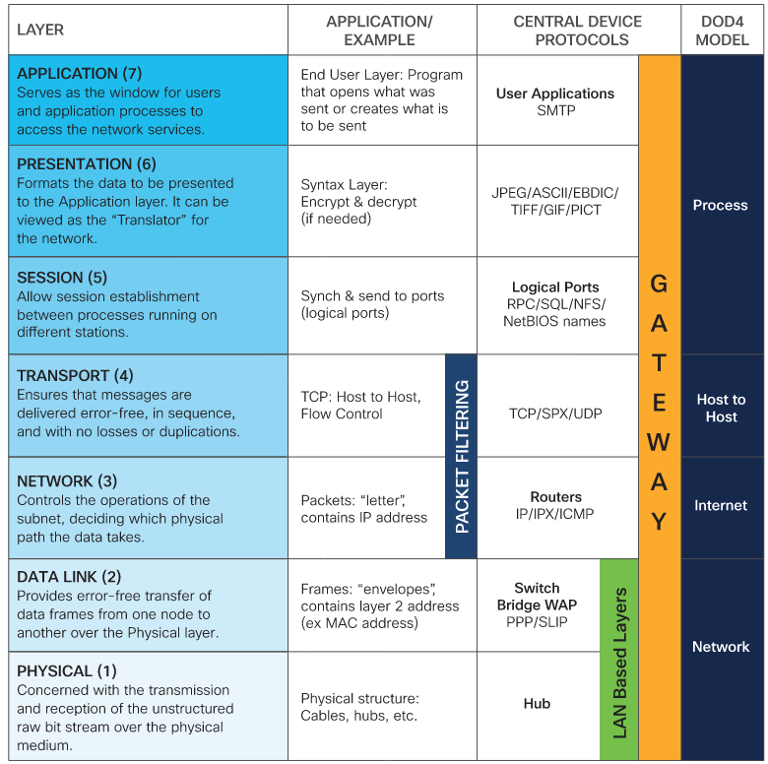
Putting IoT into perspective: The Open-Systems Interconnect model
Cloud
Edge
IoT
OSI Model Reference Chart (cisco.com)
Notes:
To put the cloud, edge, and physical devices into further perspective, one must first consider how they incorporate into the OSI model behind the operation of the internet.
At each level of communicability, there are countless devices, protocols, standards, and tidbits of knowledge required for success.
The IoT that I refer to henceforth is thus related to the lowest of layers, where the physical devices themselves interact.

Slide 16
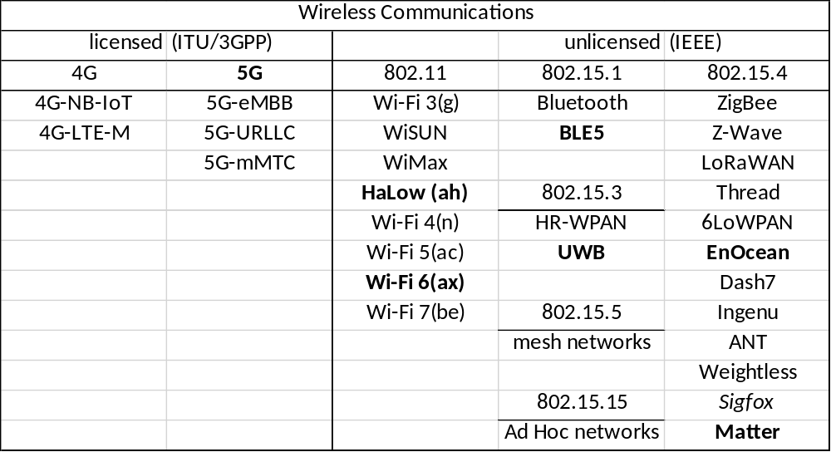
PROBLEMS: 4.) Complexity
Notes:
To elucidate the complications on these lower three levels, consider how many different means there are to communicate between devices.
This list is non-exhaustive, but it should first be noted that most construction companies are hogtied by the services provided by the cellular grid.
The licensed spectrum is used for robustness and simplicity, but when it fails… what next? Practitioners experiment heavily with the unlicensed spectrum,
But the number of available options in terms of protocol and standard make the unlicensed world a difficult one. I recommend the items in bold for further research if interested.

Slide 17
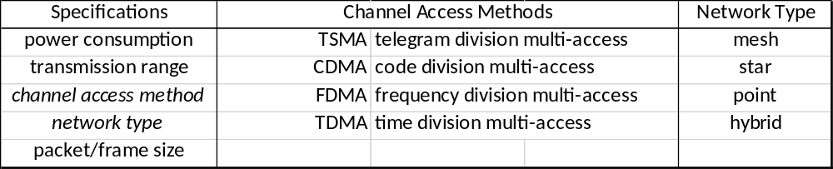
PROBLEMS: 4.) Complexity (Variables)
Considerations:
Cyber-security
Quality-of-Service
Energy Harvesting
Robustness
Ruggedness
Notes:
The reason there are so many unlicensed offerings is because of the number of variables that change between them: power consumption, transmission rate, and frame size are easily quantified.
However, without the proper association of channel access method and network type, the interoperability between devices will fail to exist.
Further considerations must include the inherent needs for cyber-security, quality-of-service (lost data), device durability, and so forth.

Slide 18
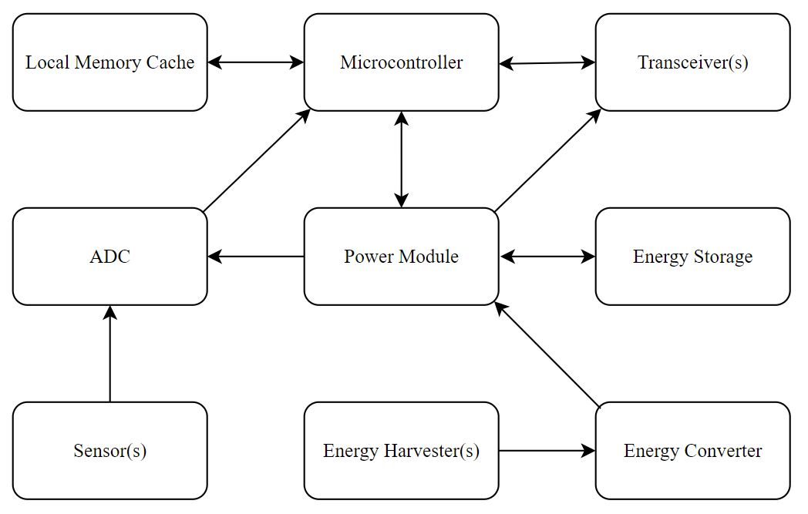
PROBLEMS: 5.) Interoperability
Notes:
Furthermore, amidst the discussion of interoperability, one must recognize that many electronics are embedded into what is commonly seen as an “IoT device” or “sensor node.”
In result, the devices can cause issues in unforeseen places like the local memory cache (which I will bring up again in a later example)

Slide 19
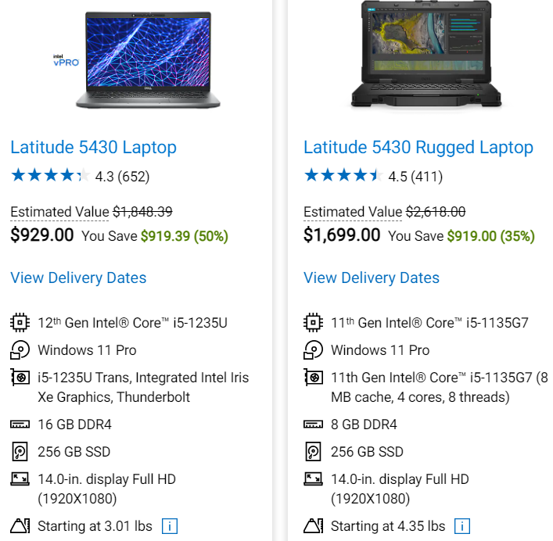
PROBLEMS: 6.) Usability
7.) Cost
https://www.dell.com/en-us/search/latitude%205430
Notes:
To conclude the many problems that I have posed within successful network and device integration, it should be noted that without sufficiently rugged equipment,
construction professionals should expect large costs related to physical failures and compromised nodes.
Yet ruggedization must be a proactive investment, which must take into consideration the nearly double or triple costs associated. Ex. The weaker laptop above in terms of computing capability,
Is twice as expensive as the alternative simply due to the rugged housing it’s built within. As a side note on usability, brightness and sensor sensitivity with regards to controls are often a problem.

Slide 20
Solutions
Notes:
Now that we’ve elaborated on the problems in network and device integration, what are some potential solutions?

Slide 21
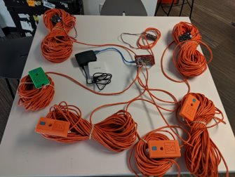
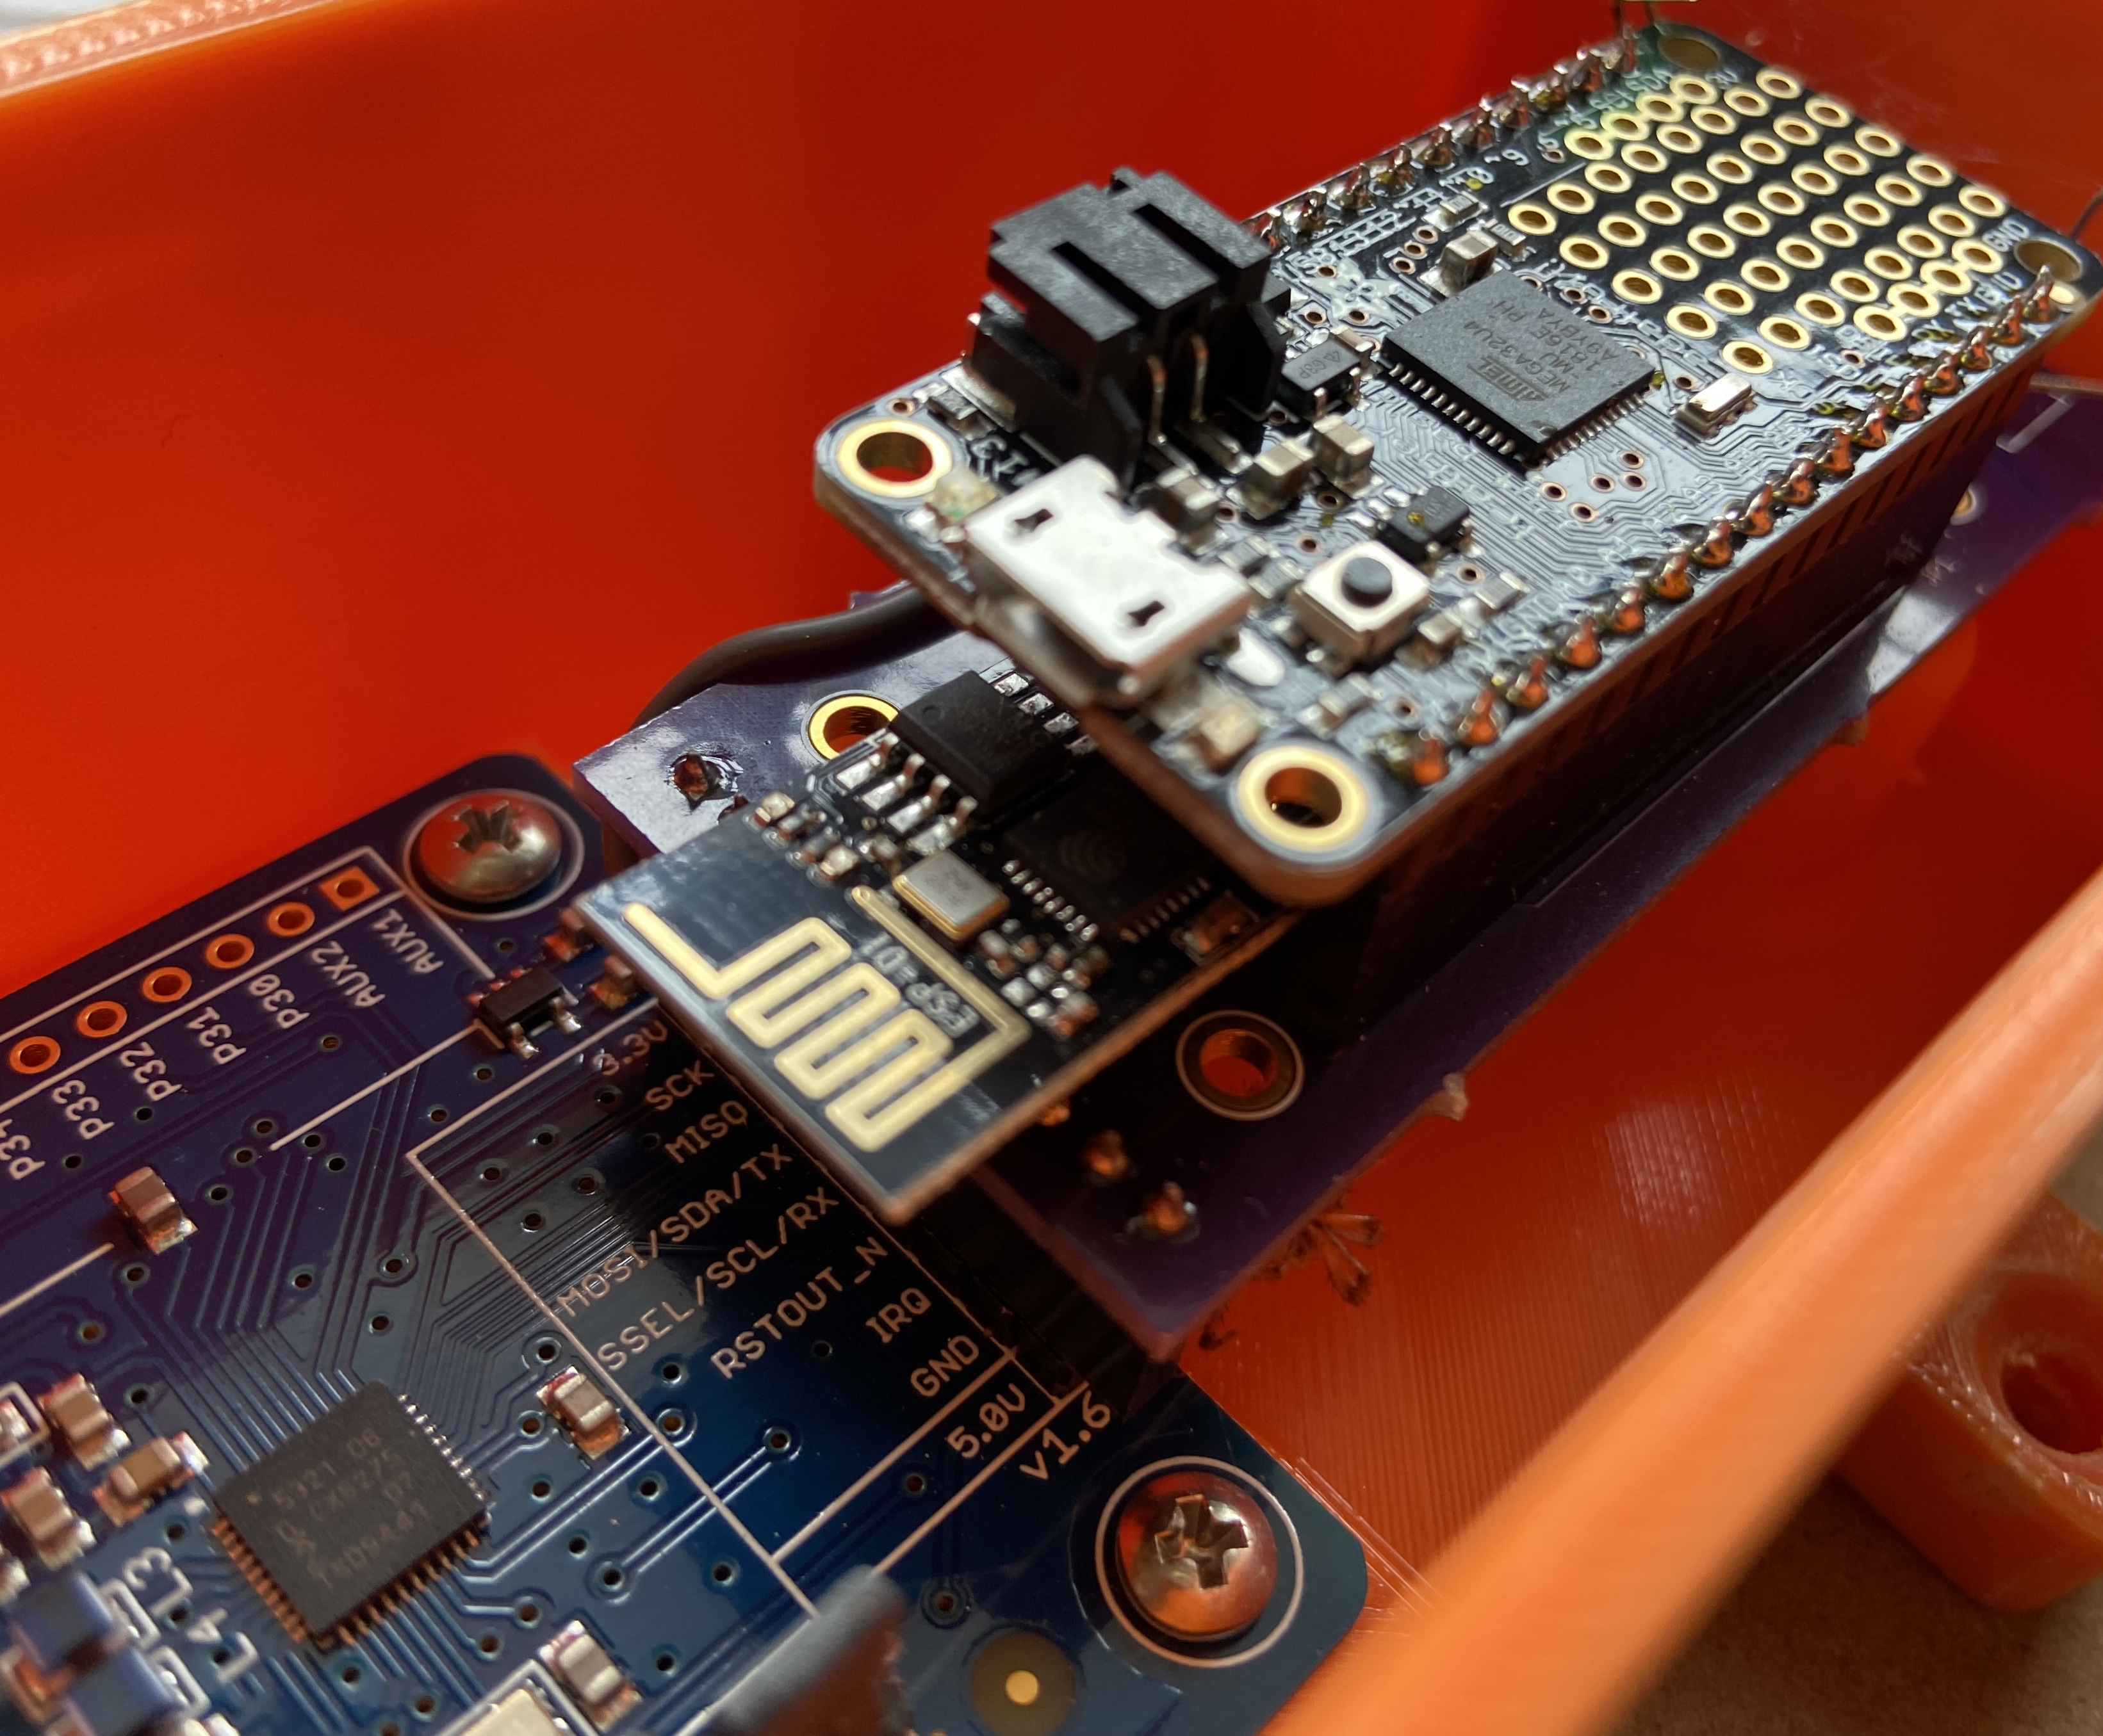
SOLUTIONS: 1.) New Workforce
Notes:
Technology indubitably has the potential to offset human labor, but new laborers must be involved to purchase, design, install, calibrate, and monitor the devices used in construction.
This is largely because of the highly context specific applications that I’ve heard a few of the other presenters mention within the last few days. Here’s a personal example:
In attempting to extract environmental and labor-related data from a jobsite, one contractor first used wired power over ethernet to overcome the difficulties of wireless device onboarding.
After hiring a programmer for code and myself for electronics development, a wireless network was made. However, as mentioned previously, inadequacies of our design existed.
Namely, we failed to make an onboard memory cache of sufficient size for the cloud-stream that was intended to be constant. This proved faulty because (even though a considerable budget was invested in a cellular contract) the cellular broadband internet provider retained the power to incorporate data caps and constrictions that caused our systems to unpredictably drop from their service for the sake of the local community.

Slide 22
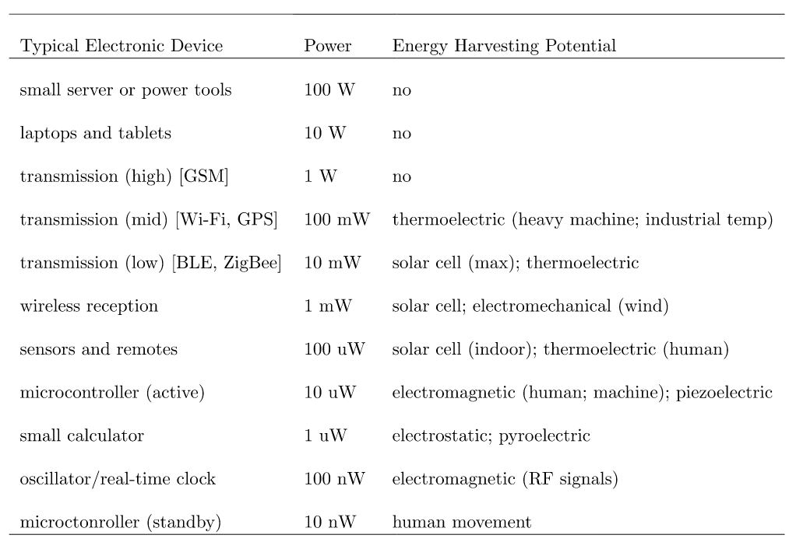
SOLUTIONS: 2.) Energy Harvesting
Notes:
Furthermore, the previous example still required considerable battery consumption, or alternatively had to be plugged-in as well.
Whilst this was obviously not optimal, it’s exciting to know that great bounds in energy harvesting potential are being made. In fact, energy harvesting has, likely, the most potential for growth.
In fact, I have recently learned of some new technologies that greatly increase the capability of electromagnetic and electro-mechanical beyond what is listed above.
These technologies are still confidential and won’t be on the market until likely the middle of 2024 though, so stay tuned for that.

Slide 23
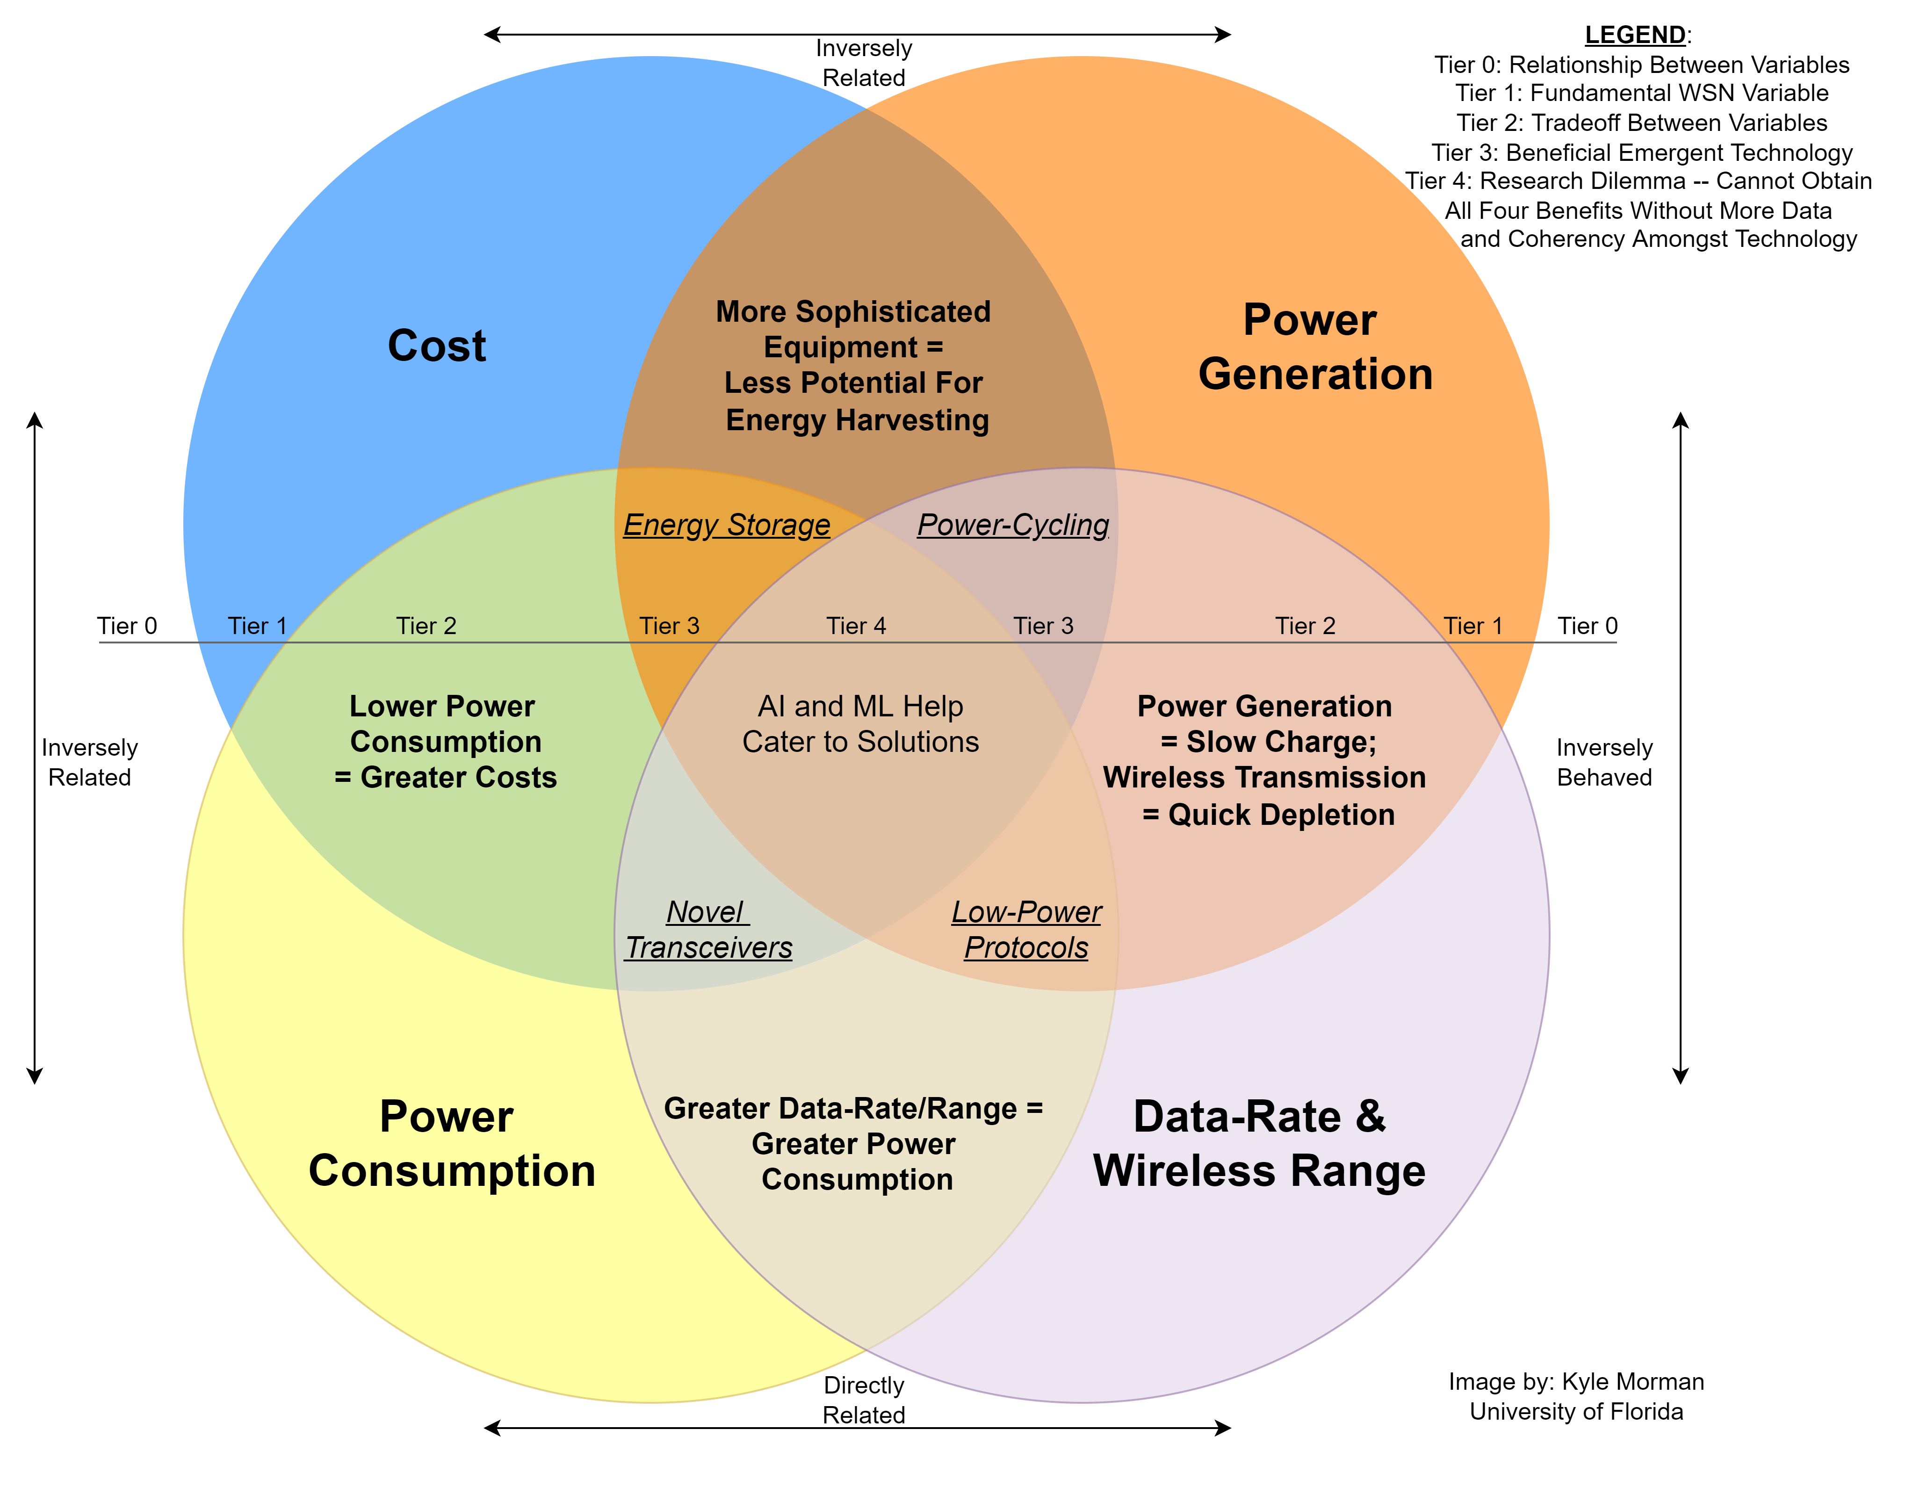
SOLUTIONS: 3.) Artificial Intelligence
Notes:
Indeed, to simplify everything discussed thus far, one could consider the tradeoffs between wireless needs, power capabilities, and costs by the Venn Diagram shown here.
To quickly summarize, there are individual areas of research with many academicians and practitioners studying the relationships between each above variable.
More importantly however, artificial intelligence and machine learning algorithms can now be developed for the incredible optimization needed to successfully weigh these tradeoffs beyond human capability.

Slide 24
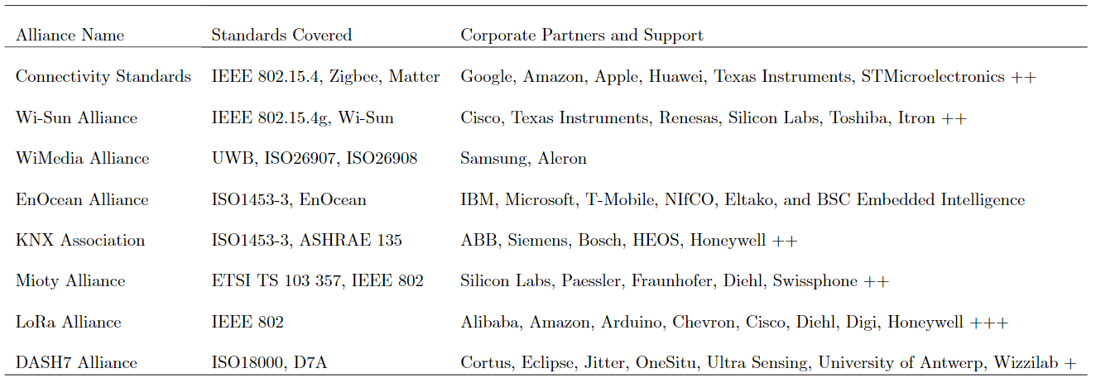
SOLUTIONS: 4.) Standardization
Notes:
Being a European conference, I must now commend the audience for the standardization efforts made on this continent that really drive the United States interoperability potential.
Standardization alliances are ensuring that proprietary device manufacturers understand and utilize the commercial potential of making their components capable of interacting with other mfrs.

Slide 25

Open-Source Coding
SOLUTIONS: 5.) The Open-Source Paradigm
                Control Panel:
                written in Dart using Flutter GUI framework,
                hosted on GitHub Pages. Protocol buffers
                help with interoperability. WebSocket
                reduces power consumption.
https://www.github.com/fridgigators​
https://fridgigator.github.io/control-panel/
Notes:
On top of interoperability generated by standardization alliances, there is also the open-source paradigm that greatly assists the application/context-specific conundrum previously noted.
One personal experiment was an interoperable smart refrigerator, written in Dart using Flutter GUI framework, hosted on GitHub Pages. Protocol buffers help with interoperability. WebSocket
reduces power consumption.

Slide 26
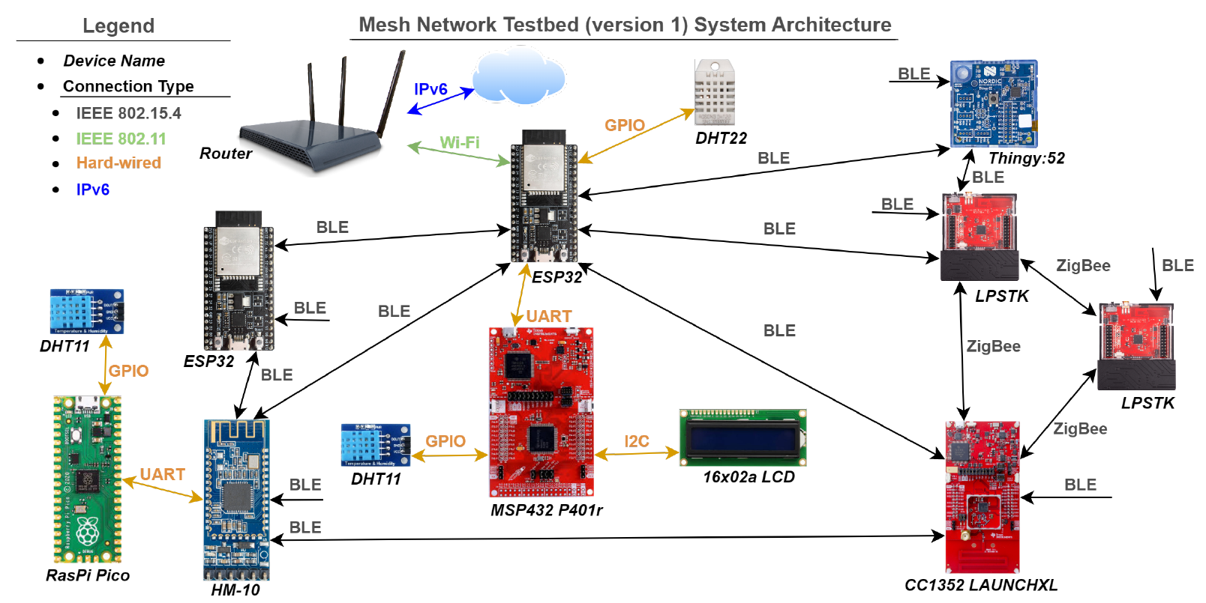
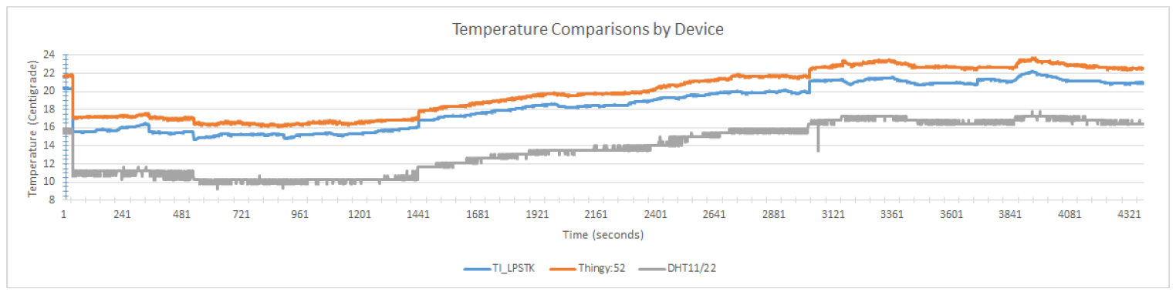
SOLUTIONS:
1.) New Workforce
Notes:
Here is an overview of the established smart refrigerator system.
Again, the new workforce that needs to be developed is displayed by the errors shown in the bottom graph.
Although devices of disparate manufacturer can now successfully communicate using available online libraries, there is a calibration needed: for although the three sensors shown were in the same location of same temperature, there is a nearly 10-degree centigrade difference between the resulting calculated temperature values.

Slide 27
Takeaways / Conclusion
Considering the interrelatedness between connectivity, energy, hardware, software, and human requirements within IoT…
Ruggedness is expensive, but necessary.
A new workforce/department needs to be established to ensure IoT success
Energy-Harvesting Microelectromechanical systems solve the power bubble.
Artificial intelligence will help in optimization.
Standardization efforts have been made for interoperability.
As more coherency evolves, future research is required
to evaluate network systems in the IoT.
Notes:
In conclusion…

Slide 28

This material is based upon work supported by the National Science Foundation under Grant Number 2004544.
https://wam.ece.ufl.edu/research/iot/
Thank you for your time.
Notes:
Thank you all. My email is shown in the bottom left and I have recorded this presentation.
If anyone wants to review this material further in the future, simply email me, add me on LinkedIn, give me a phone call, what have you.
I would be more than happy to share this presentation with any interested parties.

